Slide 1
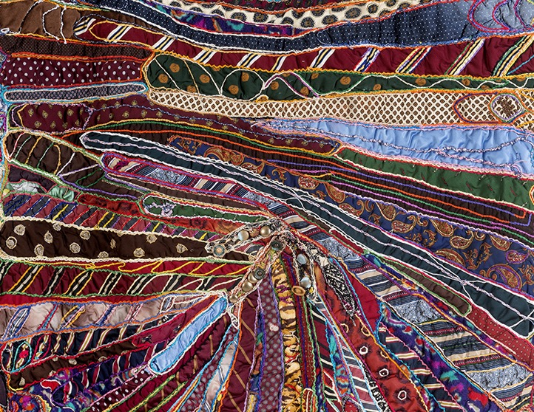
Goya Contemporary
Goya-Girl Press
Elizabeth Talford Scott
Baltimore

Slide 2
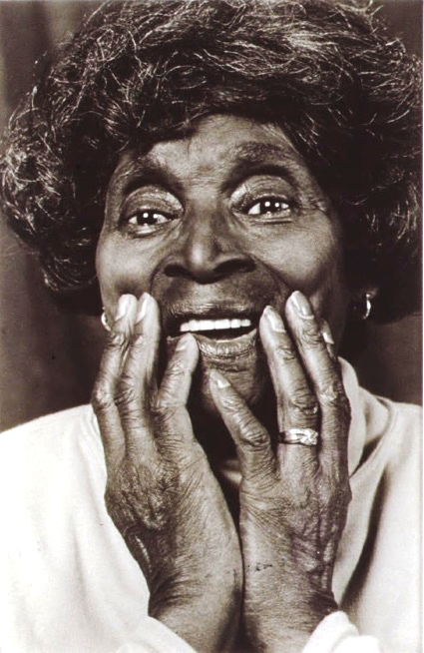
Elizabeth Talford Scott
Elizabeth Talford Scott (1916-2011) was born near Chester, South Carolina on the land her parents worked as sharecroppers, and where previously her grandparents were held as slaves. The sixth of fourteen children who lived on the Blackstalk Plantation, Elizabeth was trained by age nine to repurpose scrapped materials into usable objects to accommodate basic survival needs. Quilting was a familiar part of the black American experience, especially in the South. It was a keystone for innovation, upcycling, constructed iconography, and passing historical narratives from one generation to the next. The artist honed her quilting skills at a young age, though her invention within the medium would develop over many years, moving away from domestic function into sculptural wall hangings that live squarely within the vernacular of fine art.
Migrating to Baltimore in the early 1940’s, Elizabeth and Charlie Scott, Jr., welcomed into the world their daughter, celebrate artist and MacArthur fellow Dr. Joyce J. Scott. During this period, Elizabeth Scott worked as a caterer, a caregiver to children, and a mother. With limited time in her demanding work schedule, Elizabeth Talford Scott took a hiatus from quilting. It was not until her daughter was self-sufficient, in the 1970’s, that the artist returned to her creative practice with dedication, vigor and potency. Developing techniques that acknowledged her family history yet moved beyond, Scott began to innovate, creating Fiber works that incorporated stones, buttons, shells, bones, sequence, beads, knotted material, glass, and other unconventional objects amassed in bright and lively compositions that boasted bold colors and heavily layered surfaces in organic and unstructured shapes.
Immersed and embedded within the lush surfaces of these works live personal and worldly narratives, and an alphabet of symbols that tell us as much about emotion as they do about personal history. Her developed iconography makes references to nature, flowers, animals, insects, sea creatures, monsters, fantastical beings, magic, superstitions and good luck charms which converge in a cacophony of pure visual energy. In Scott’s hands, commonplace materials are transformed into a lesson on abstract design informed by all that she could see and imagine.

Slide 3
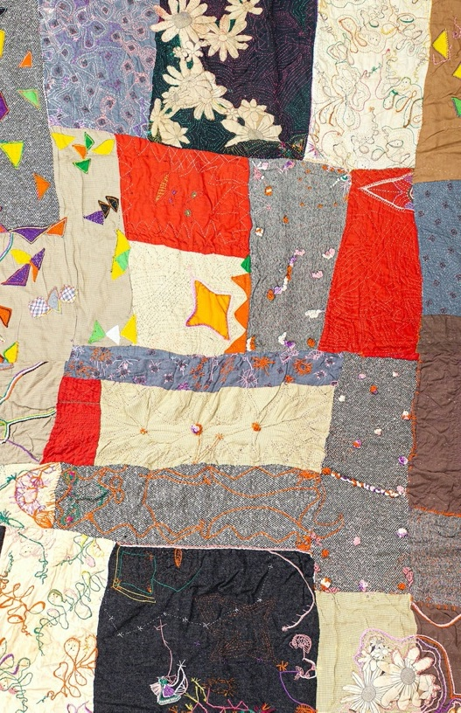
During her lifetime, Elizabeth exhibited in Baltimore as well as national venues including The Studio Museum of Harlem, NY; The Museum of American Folk Art, NY; and The Metropolitan Museum of Art. In 1998, she was the subject of a retrospective exhibition titled Eyewinkers, Tumbleturds, and Candlebugs: The Art of Elizabeth Talford Scott that opened at the Maryland Institute College of Art and traveled to the Smithsonian Institution’s Anacostia Community Museum in Washington, DC among other venues in New England and North Carolina. In 1987, Elizabeth Talford Scott was bequeathed the Women’s Caucus Award for Outstanding Achievements in the Visual Arts. The artist regularly produced workshops, frequently collaborating with her daughter, Joyce J. Scott, to educate students on methods and material usage in her craft.
Elizabeth Talford Scott died in 2011. In 2019, Scott was the joint subject of the exhibition Hitching Their Dreams to Untamed Stars: Joyce J. Scott & Elizabeth Talford Scott at the Baltimore Museum of Art. That same year, the duo was also the subject of Reality, Times Two: Joyce J. Scott & Elizabeth Talford Scott at their primary gallery, Goya Contemporary, in Baltimore, Maryland. In 2020 - 2021, Elizabeth Talford Scott’s work will be included in several museum exhibitions including at the Philbrook Museum and the Mint Museum. Her Posthumous success points to long standing, systemic institutional structures that failed to recognize the work of significant female makers in their lifetimes, but one that has recently prompted curatorial corrections and reinvestigation into these important practices. We cannot tell the authentic story of American Art without including the significant contributions of female, indigenous, LGBTQ, immigrant, and BIPOC makers. Elizabeth Talford Scott has been cited by many contemporary, celebrated artists as an influence, counting her own daughter, Joyce J. Scott among those she impacted. Scott’s works feel as fresh and relevant today as the day they were constructed, proving Scott a significant artist who was not only of her time, but ahead of her time...if not, timeless.
© 2020 Goya Contemporary Gallery and The Artist Legacy Project LLC.
All rights reserved. No part of this publication may be used or reproduced in any manner whatsoever without written permission from the copyright holder.

Slide 4
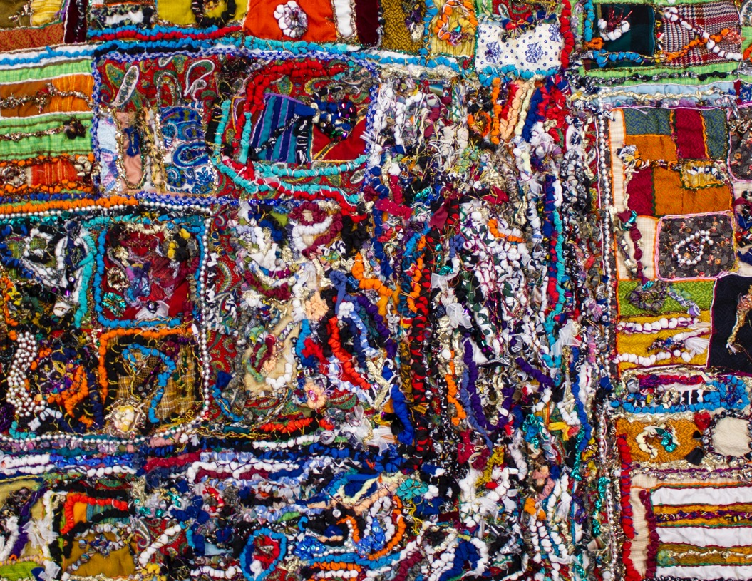

Slide 5
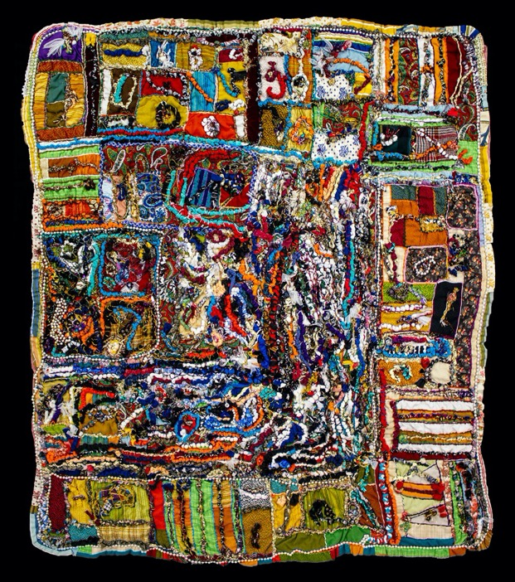
Elizabeth Talford Scott
Birthday, 1997
Fabric, thread, mixed media
62 x 55 1/2 inches
TScot-1019-C

Slide 6
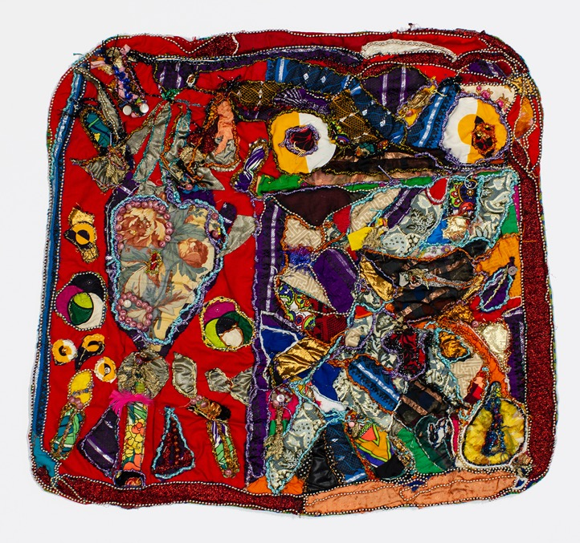
Elizabeth Talford Scott
Abstract 27, 1993
Mixed media
30 1/2 x 33 inches
TScot-1008-C

Slide 7
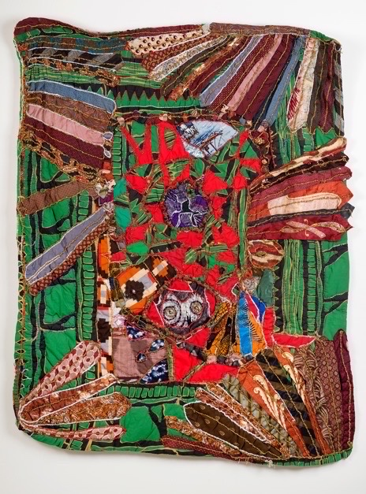
Elizabeth Talford Scott
Birthday Quilt, 1994
Fabric, Mixed Media
60 x 52 inches
TScot-1004-C

Slide 8
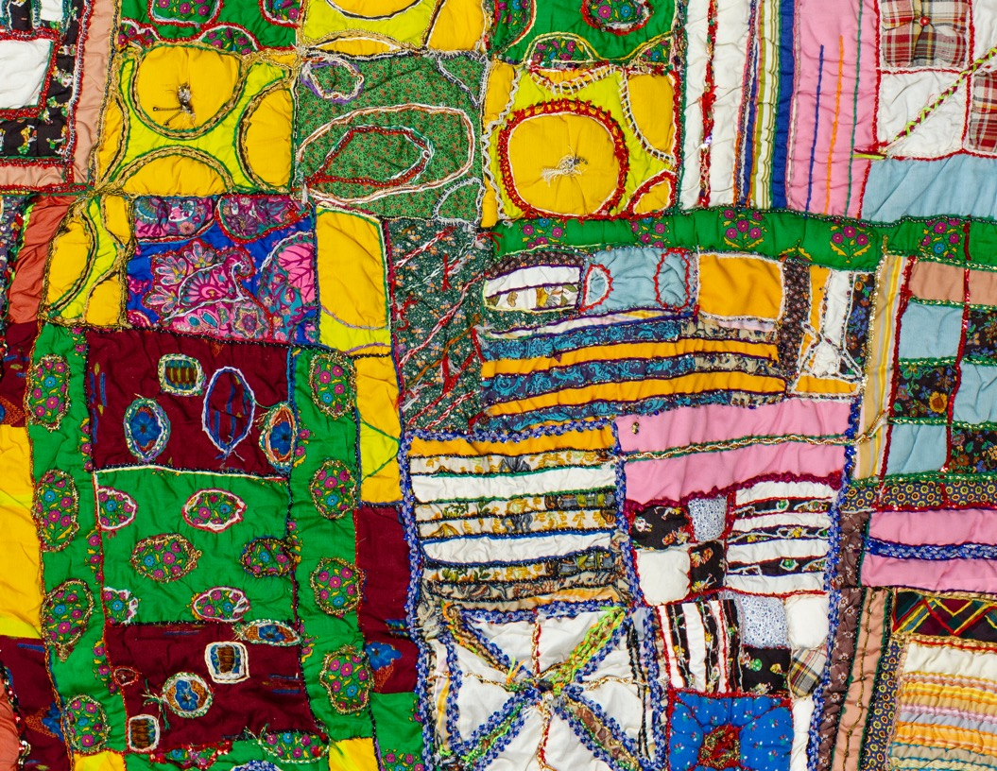

Slide 9
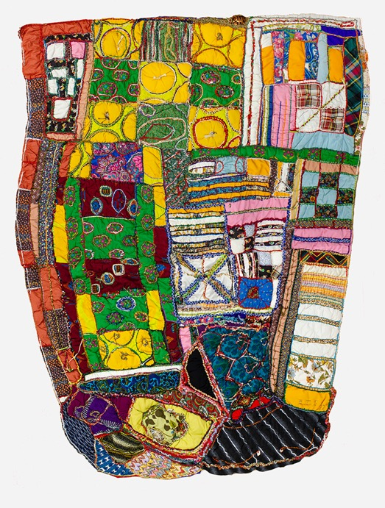
Elizabeth Talford Scott
Save the Babies, 1992
Mixed media
78 x 59 inches
TScot-1011-C

Slide 10
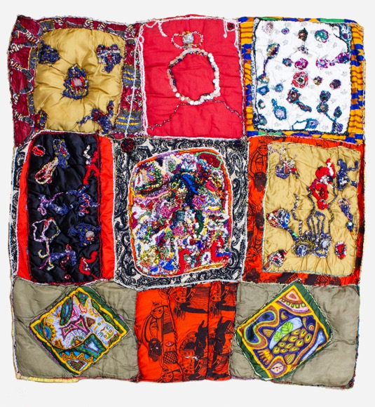
Elizabeth Talford Scott
Bits and Pieces, 1995
Mixed media
53 1/2 x 53 inches
TScot-1013-C

Slide 11
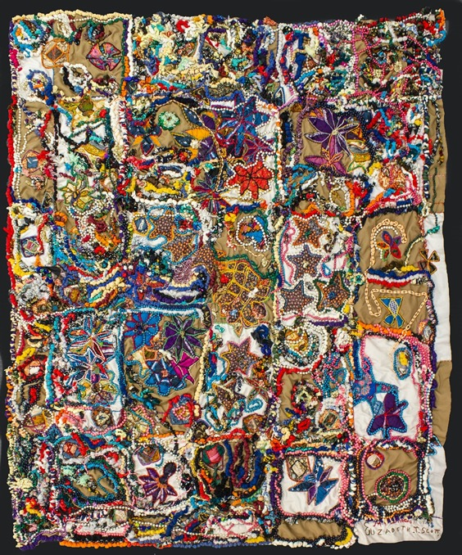
Elizabeth Talford Scott
My Dreams, 1987-98
Mixed media
71 x 57 inches
TScot-1014-C

Slide 12
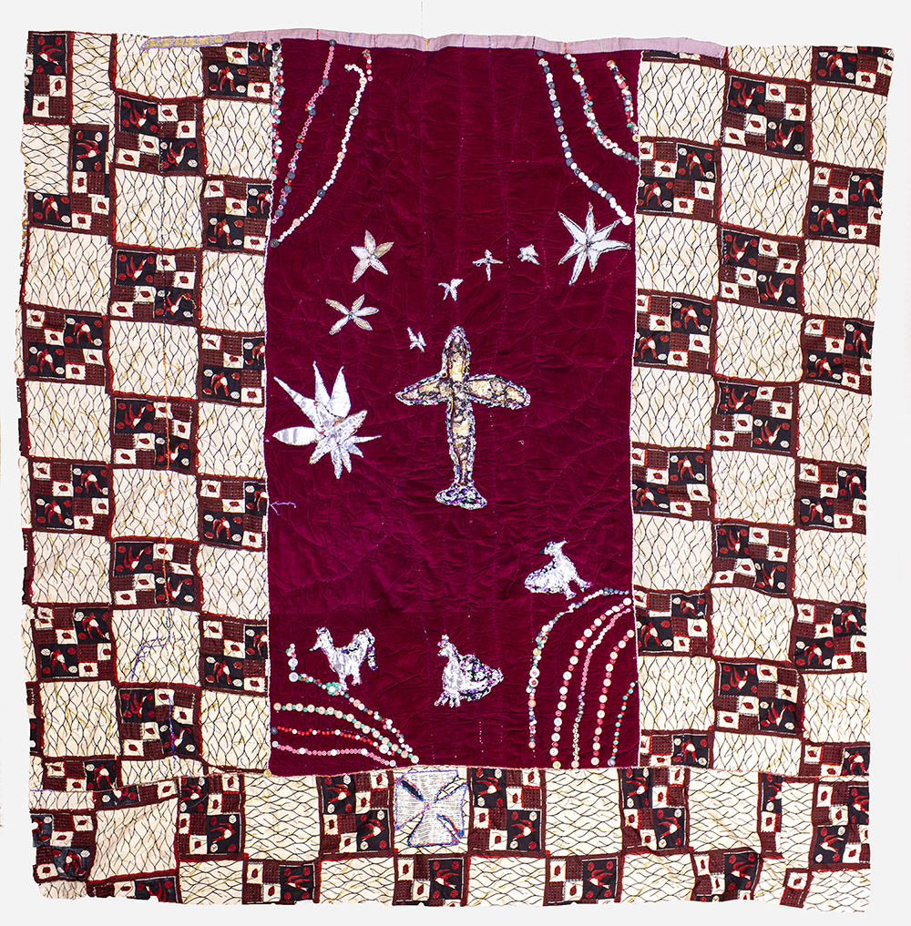
Elizabeth Talford Scott
Untitled, 1986/89
Mixed media
86 x 86 inches
TScot-1012-C

Slide 13
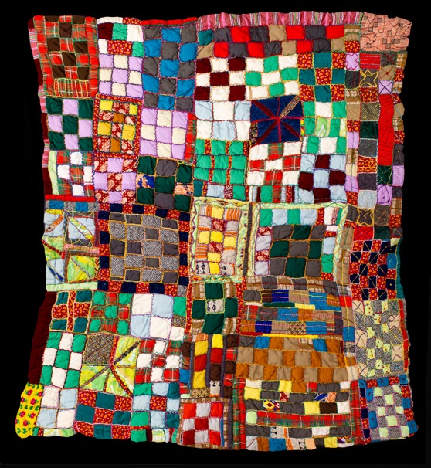
Elizabeth Talford Scott
Stamp #2, circa 1990s
Mixed media
65 1/2 x 63 inches
TScot-1016-C

Slide 14
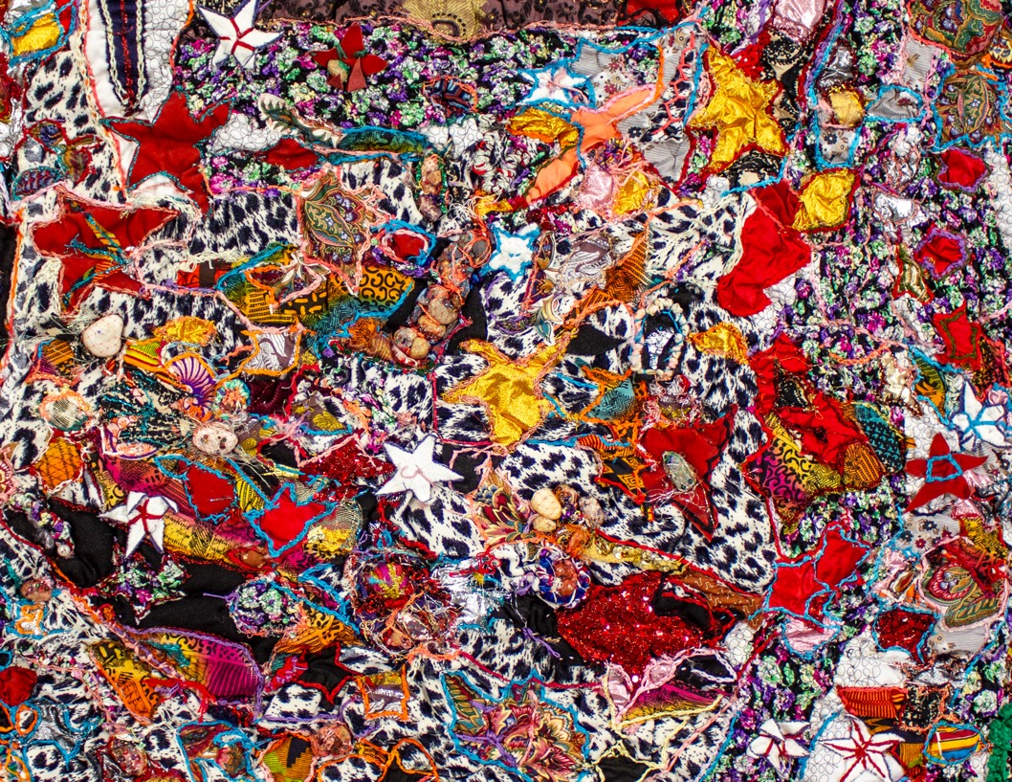

Slide 15
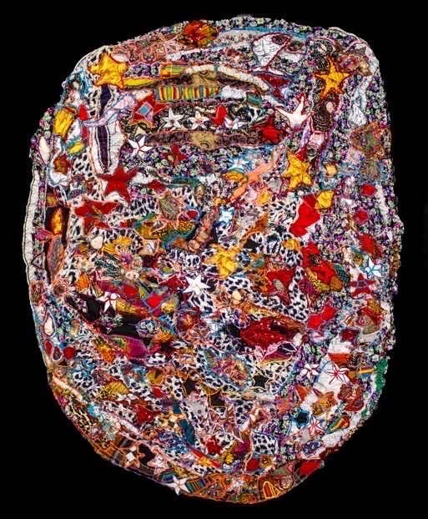
Elizabeth Talford Scott
Untitled, 1989
Mixed media
57 x 44 inches
TScot-1017-C

Slide 16
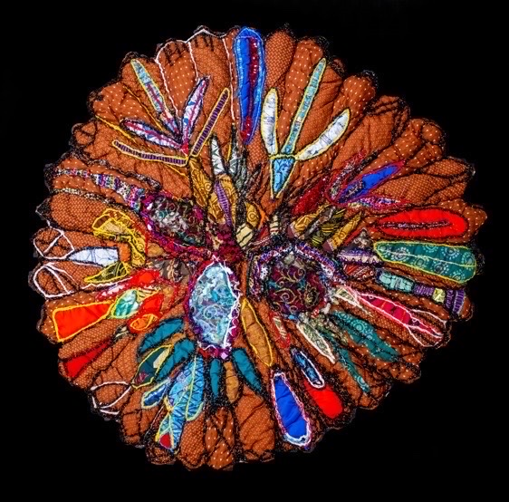
Elizabeth Talford Scott
Untitled, 1995
Mixed media
48 x 48 inches
TScot-1018-C

Slide 17
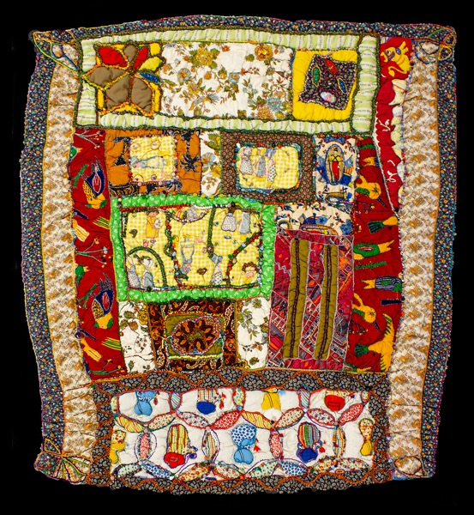
Elizabeth Talford Scott
Upside-Downwards, 1992
Mixed media
59 x 52 1/2 inches
TScot-1015-C

Slide 18
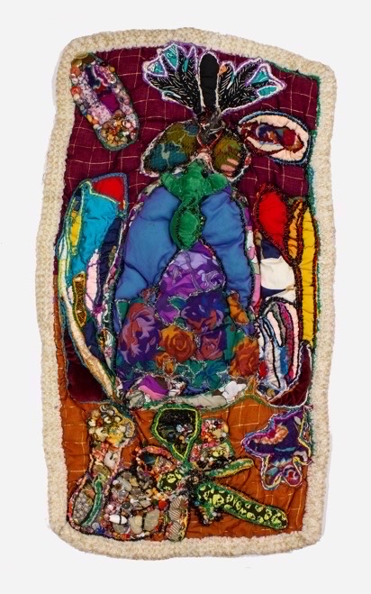
Elizabeth Talford Scott
Turtle, 1999
Mixed media
38 x 21 inches
TScot-1009-C

Slide 19
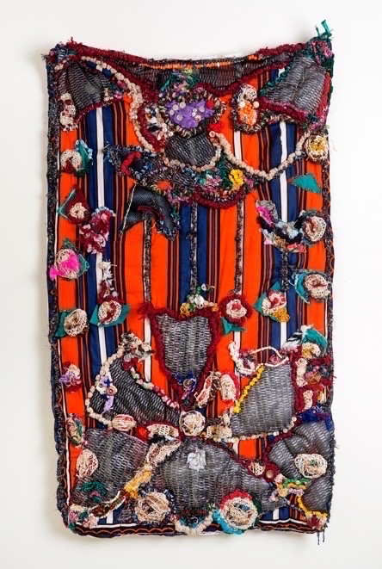
Elizabeth Talford Scott
Untitled, circa 1990s
Fabric, Thread, Yarn, Buttons, Rocks
46 x 27 inches
TScot-1002-C

Slide 20
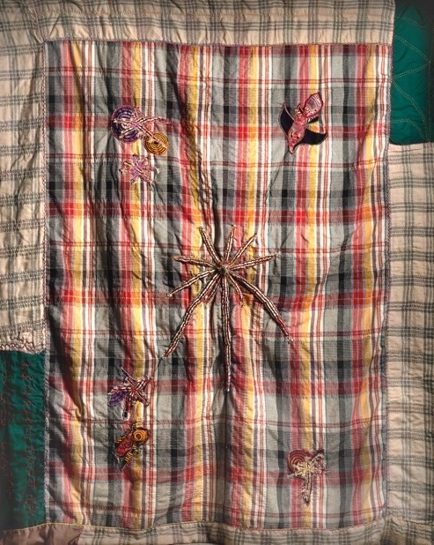
Elizabeth Talford Scott
Covered Wagon, 1983
Quilted and beaded fabric
92 x 75 inches
TScot-1006-C

Slide 21
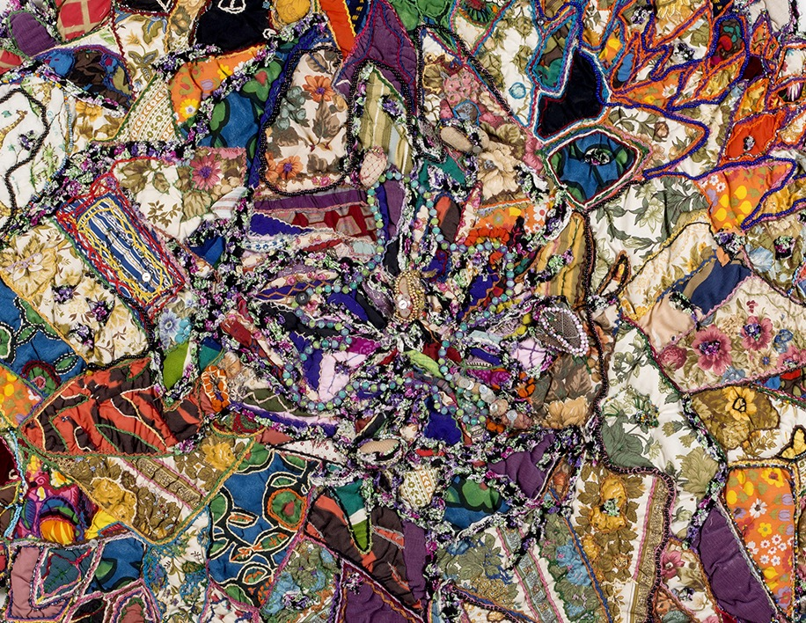

Slide 22
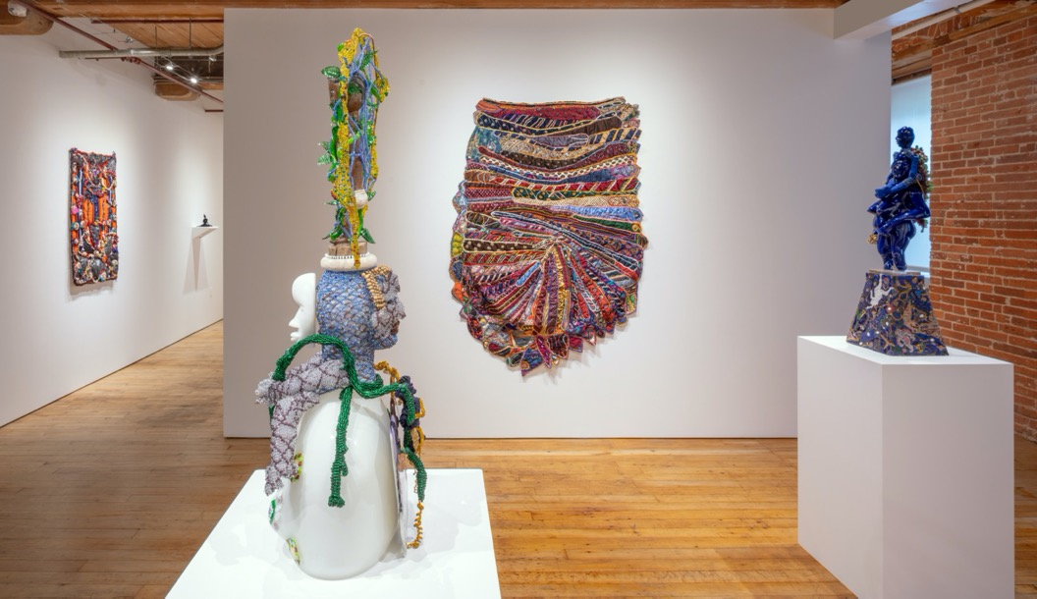
Installation of Tie Quilt #2

Slide 23
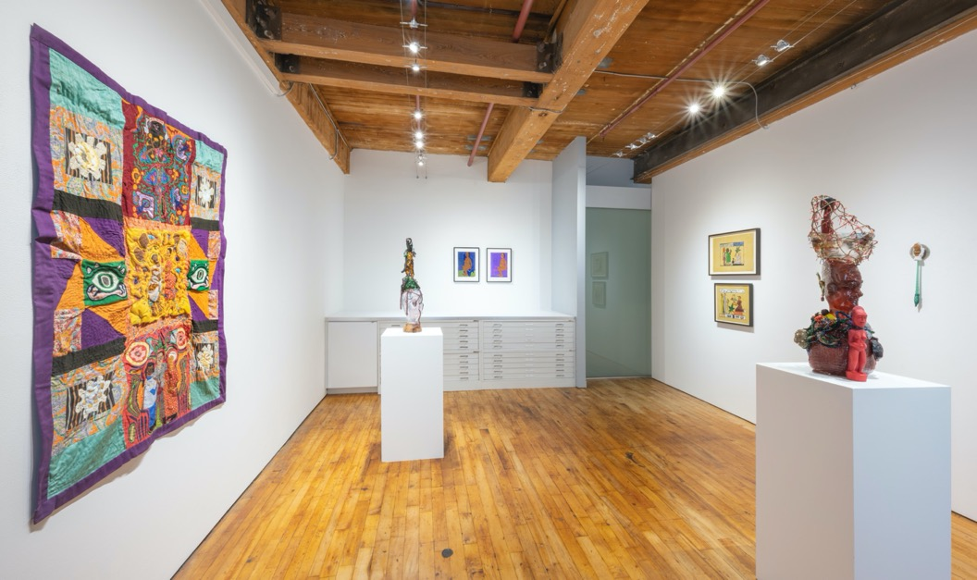
Installation of Three Generations Quit 1

Slide 24
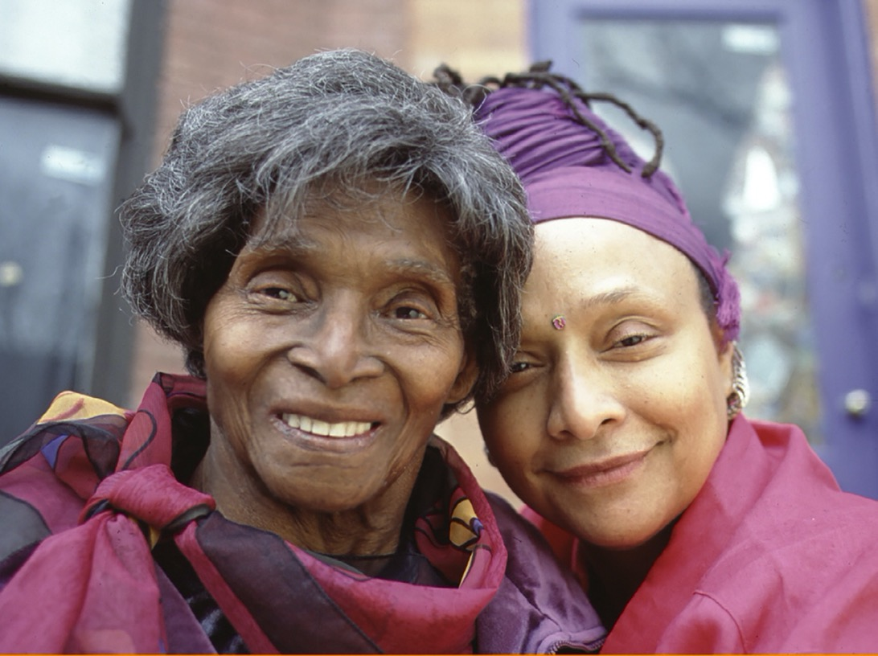
Goya Contemporary
Goya-Girl Press
3000 Chestnut Avenue | Mill Centre 214 | Baltimore, MD 21211
t. 410-366-2001 | www.goyacontemporary.com | gallery@goyacontemporary.com

